Slide 1



RIOT GAME CLONE WEBSITE

Slide 2
TEAM MEMBERS
1
Name: Agrawal Ansh
Enrollment No: 22002170210001
Roll No :- 3 Div :- C1 Branch:- I.T
Name: Shaikh Mohammed Aadil A.
Enrollment No: 22002170210115
Roll No :- 13 Div :- C1 Branch:- I.T
2
22222
4
Name: Shah Naman
Enrollment No: 22002171310126
Roll No :- 19 Div :- C1 Branch:- C.S.T
3
22222
22222
Name: Patel Rudra
Enrollment No: 22002170210086
Roll No :- 15 Div :- C1 Branch:- I.T
5
22222
Name: Patel Mihir
Enrollment No: 22002171310088
Roll No :- 33 Div :- C1 Branch:- C.S.T

Slide 3
INTRODUCTION
1
Technologies used : Html ,CSS and Javascript
2
Structure of the Project
Home Page
Valorant Page
League Of Legend Pagse
3
Use of Parallax ffect in our project

Slide 4
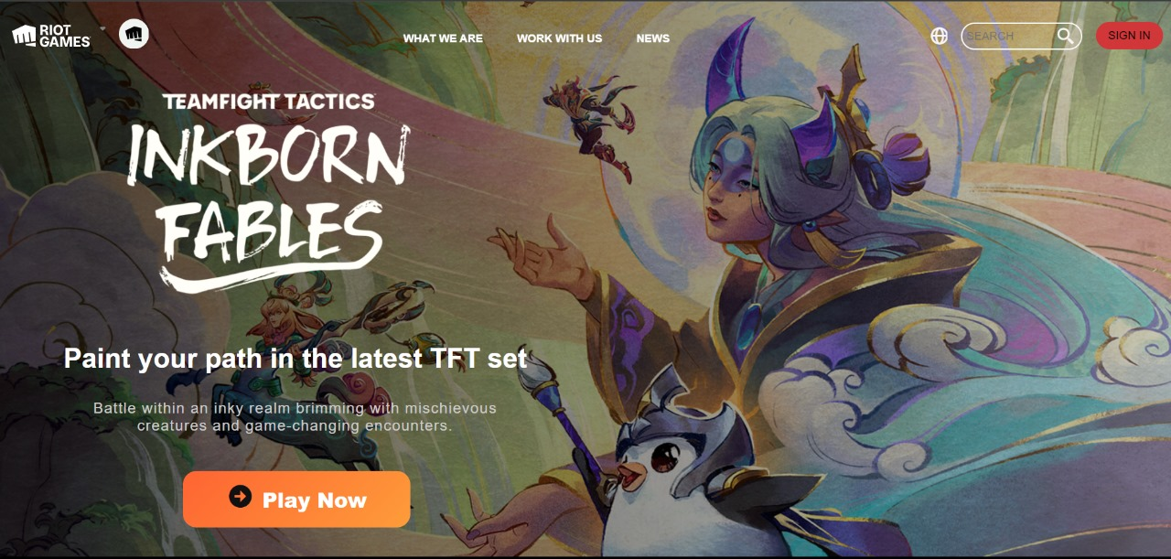
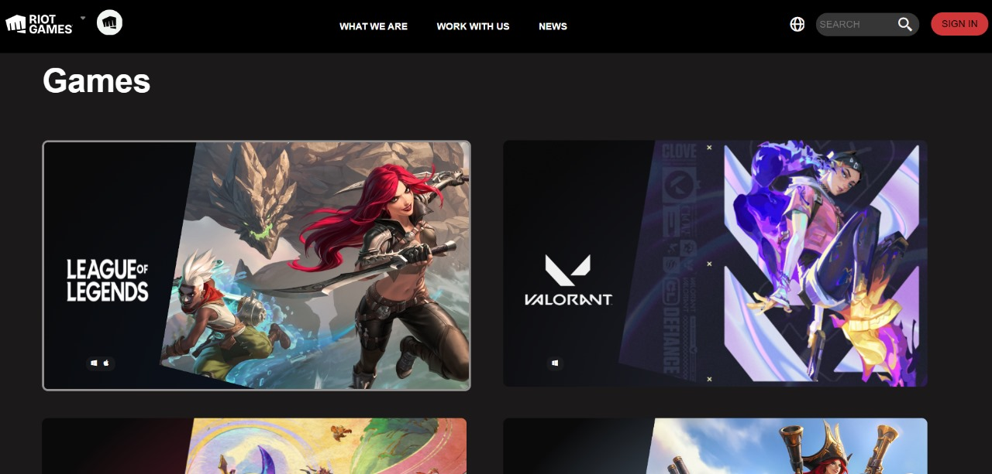
Designing the Homepage
1
Introduction and Navigation
2
Featured Content
3
News,Updates and Footer Section

Slide 5
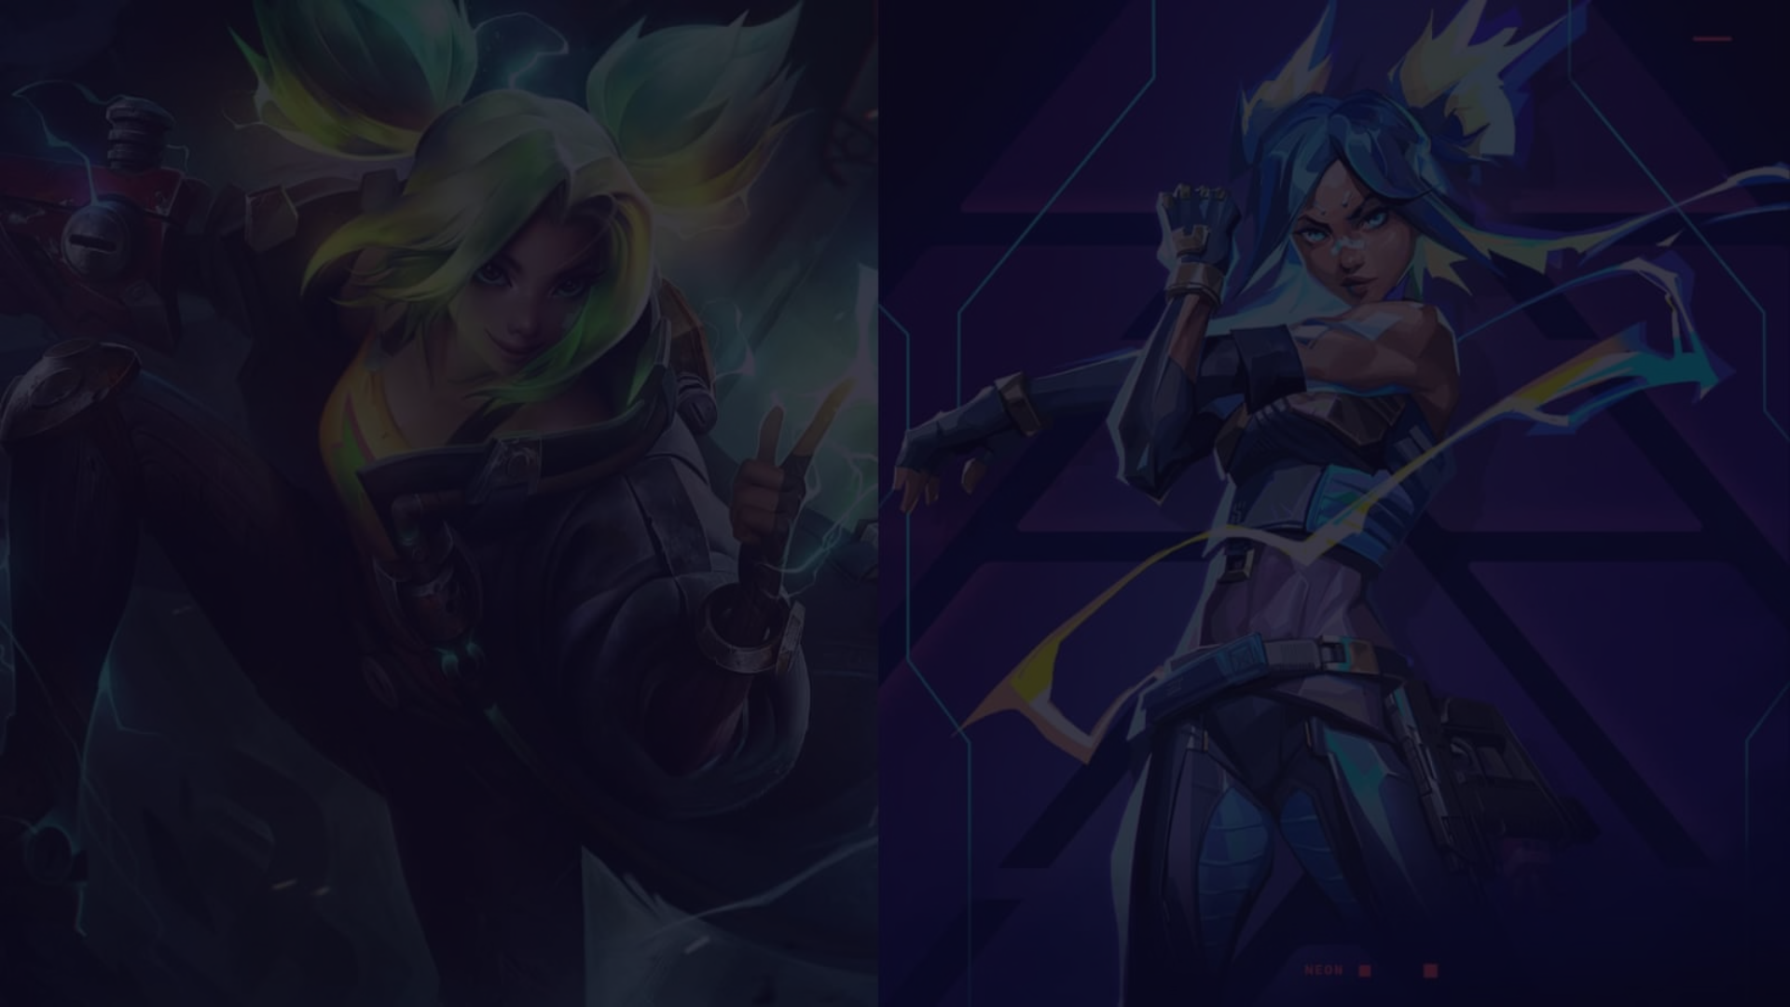
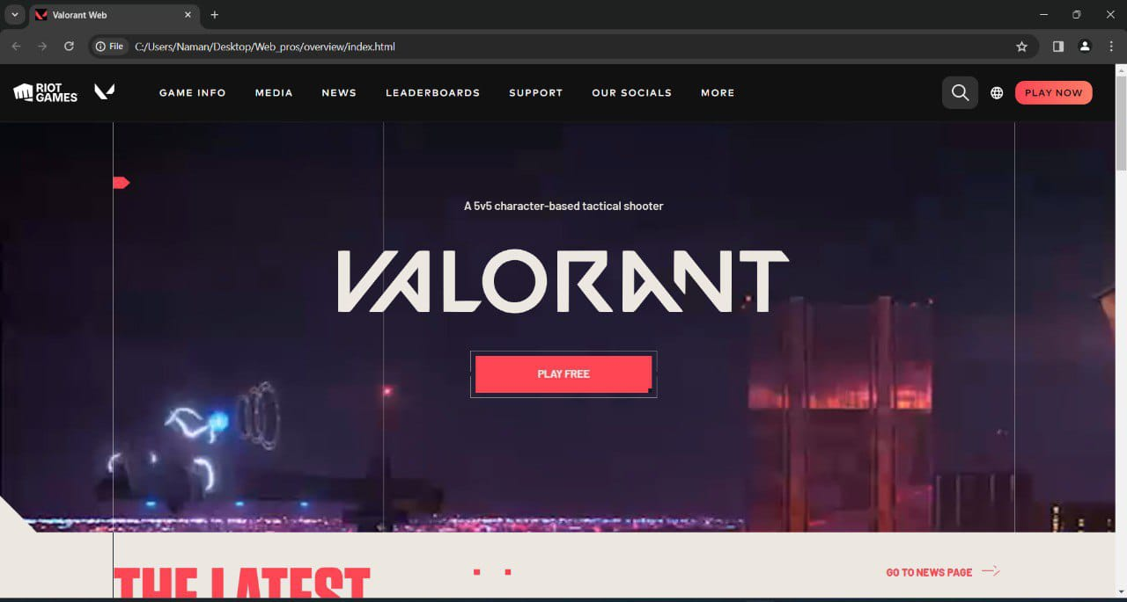
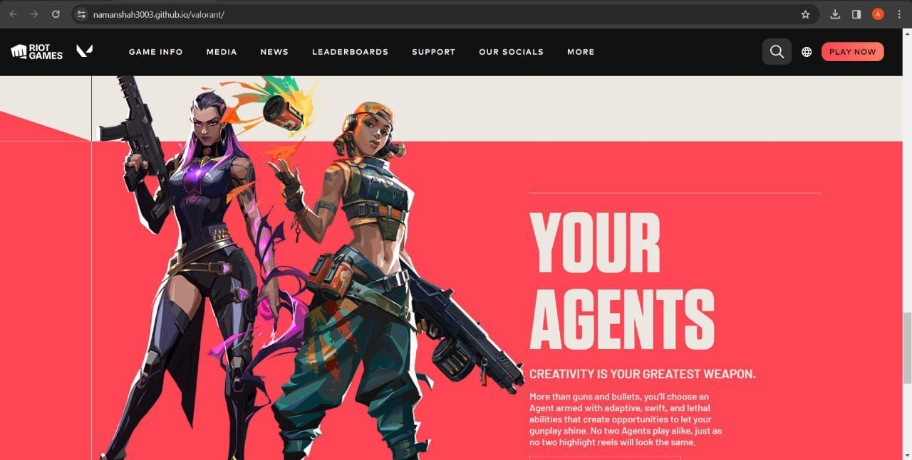
Valorant
Featured Content
Gameplay Highlight
Sections

Slide 6
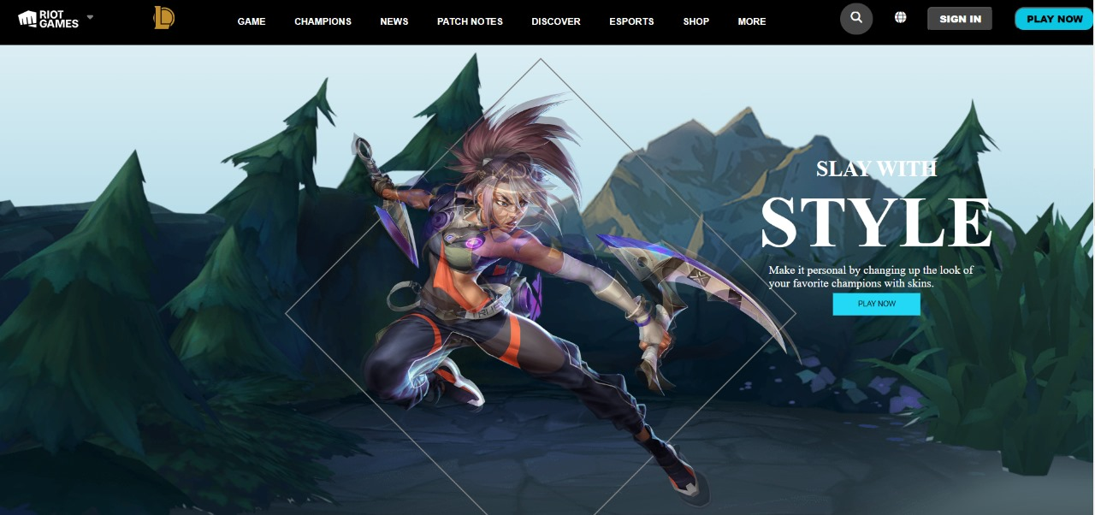
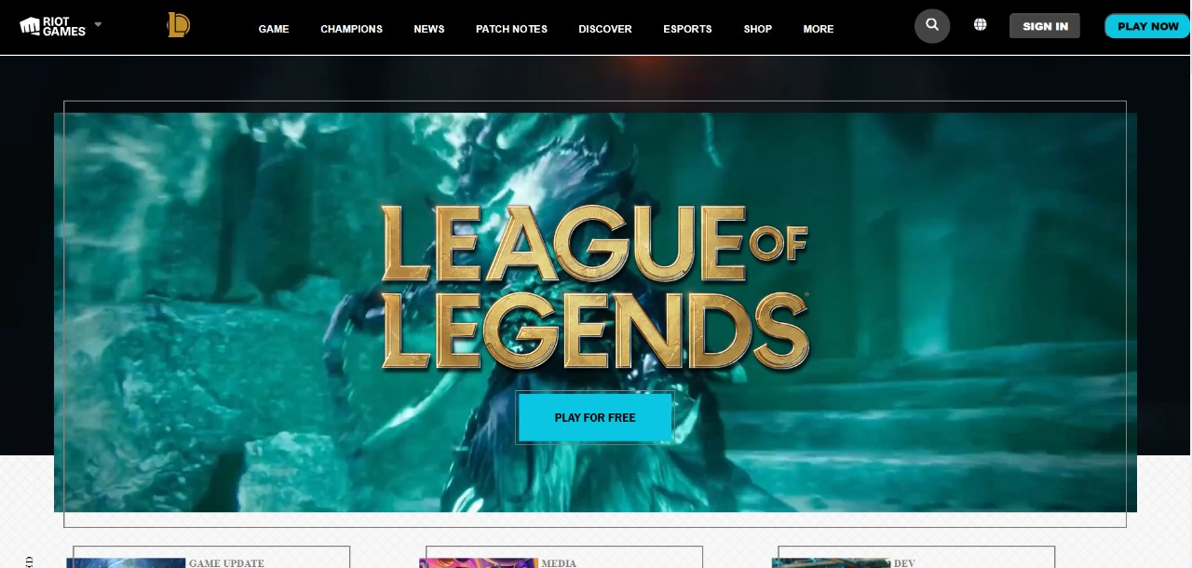
League of Legends
Parallax Effect
Gameplay Highlight
Sections

Slide 7

Challenges Overcome
Future Scope
Responsive Design
Parallax Effect
Global Reach &
Monatization
Mobile App
developement
Ensuring a consistent and seamless user experience across all devices required careful planning and iterative testing.
Implementing a parallax effect added depth and interactivity to the website, enhancing the overall user experience.
Efforts to make your web pages accessible to users in different languages and regions.
Develop mobile applications for
iOS and Android
platforms to reach users
who prefer gaming on
mobile devices.

